Slide 1

SIG React 04-09-2018

Slide 2
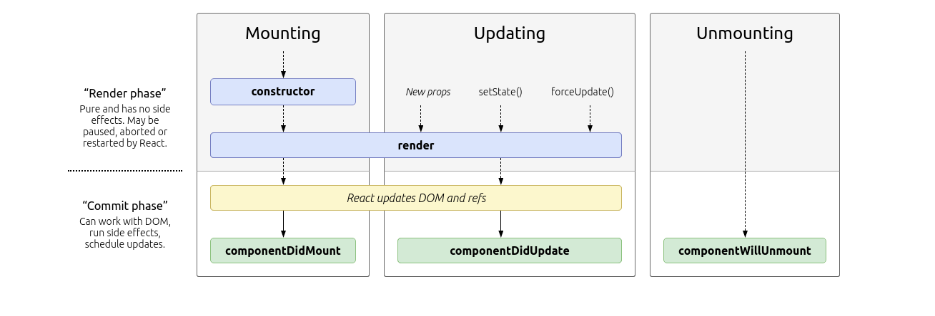
Lifecycle methods
React
<number>

Slide 3
Fetch API
Replaces XMLHttpRequest
Promise which returns the json
Browser function:
Framework independent
{
headers: {…},
method: “...”,
body: …
}
stream
React
<number>

Slide 4


Proptypes
Used for typesafety in the props of a component
https://github.com/facebook/prop-types
React
<number>

Slide 5
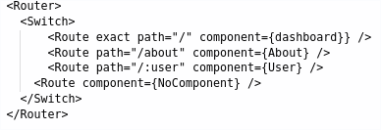
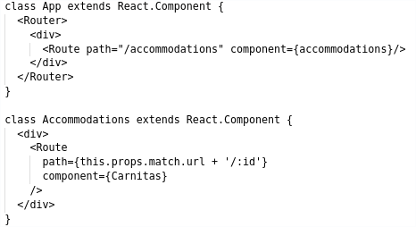
Router
Package ‘react-router-dom’
<Router> … </Router> sets up the router
<Switch> ... </Switch> takes care of exclusivity
<Route /> binds a path to a component
Declarative routing!
Add extra routes wherever you want!
React
<number>

Slide 6
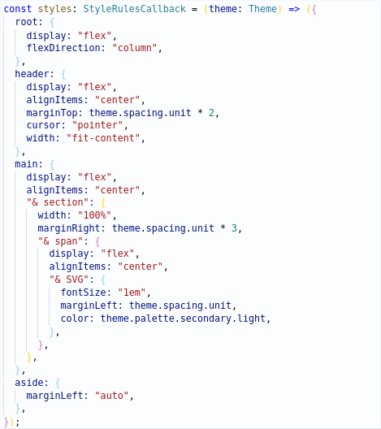
JSS
Styled components
Easy use of variables
No automatic inheritance
Scoped: no side effects!
React
<number>

Slide 7

Hands-on Time!
Questions?
React
<number>

Slide 8
Hands-on: Getting started
Git clone https://github.com/AMIS-Services/react-series
Cd into dir sig3/exercise/koa, run:
`yarn install`
`yarn start-db`
`yarn start`
`yarn seed-db`
Visit localhost:3030/accommodations to verify back-end is working
Cd into dir sig3/exercise/react, run `yarn install` and `yarn start`
Visit localhost:3000 to verify front-end is working
React
<number>

Slide 9
Hands-on: Logging in
Create a login page
Set up an uncontrolled form for username and password
Post to localhost:3030/auth
Store the JWT in local storage
Add the JWT to future requests
React
<number>

Slide 10
Hands-on: Managing user information with Fetch API
Get the user information from localhost:3030/currentUser
Use the Context API to provide the username to the AppBar
Add a menu to the Appbar with a link to the login menu. Make it read ‘log in’ when not logged in and the username when logged in.
Rework the ‘favorite’ state to be dependent on inclusion of the accommodation ID in the users ‘favoriteAccommodations’ array
React
<number>

Slide 11
Hands-on: Creating new accommodations
Add a new page at `/new` with a controlled form to add another accommodation
Post to `localhost:3030/accommodations`
Bonus: add validators
React
<number>

